Slide 1
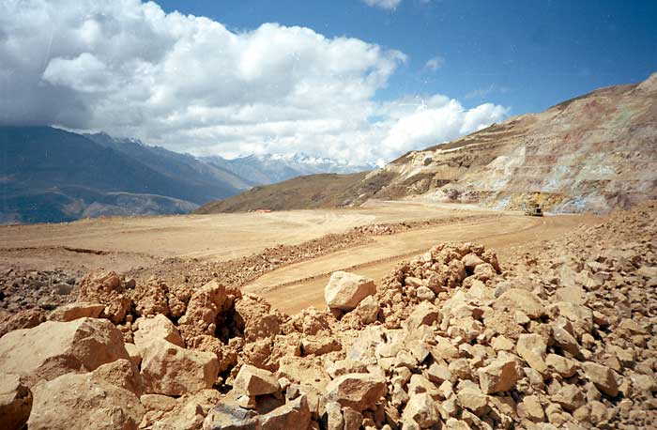
Epithermal deposit The Pierina Au–Ag deposit, Ancash, Peru
Khazhiyakparova Aigerim
17-МГР(ГР)-1,5a

Slide 2
The Pierina Au-Ag ore deposit in the Cordillera Negra of north-central Peru is a high sulphidation (acid sulphate) epithermal deposit hosted by Tertiary pyroclastics.
A 70 km belt of alteration in the Cordillera Negra corresponds to a series of eruptive centres and Pb, Zn, Cu, Ag and Au deposits (including Pierina) localised by cross structures. This alteration zone directly correlates with a Pliocene-Pleistocene graben filled with pumice and tuffs over an andesite basement. Pierina is the first high sulphidation deposit discovered in the district.

Slide 3
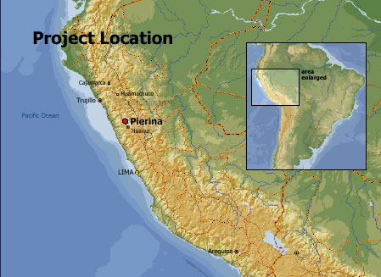

Slide 4
The hosts are rhyodacitic pumice and lithic tuffs overlying andesitic lavas, while a quartz-feldspar porphyry intrudes on the southern margin and is believed to be either late stage of post mineralisation.
The southern section of the graben contained the dome/vent from which the pyroclastics were erupted. There is a strong lithological control to the mineralisation and alteration at Pierina. Residual vuggy silica containing alunite is the main host to ore. This core zone is surrounded by alunite with minor pyrophyllite and dickite, which also locally hosts ore, in turn surrounded by an outer kaolinitic to illitic clay zone.
The pumiceous tuffs are more strongly mineralised and altered, containing the bulk of the ore, although lesser mineralised pervasive quartz-alunite is also found in the overlying lithic tuffs. The basal andesites have undergone clay-pyrite alteration with veinlet mineralisation. A sulphide feeder zone has been intersected to the south. Gold is disseminated in the vuggy-silica altered rhyodacite pumice, present as micron sized native gold grains associated with Fe-oxides, quartz and pyrite.

Slide 5
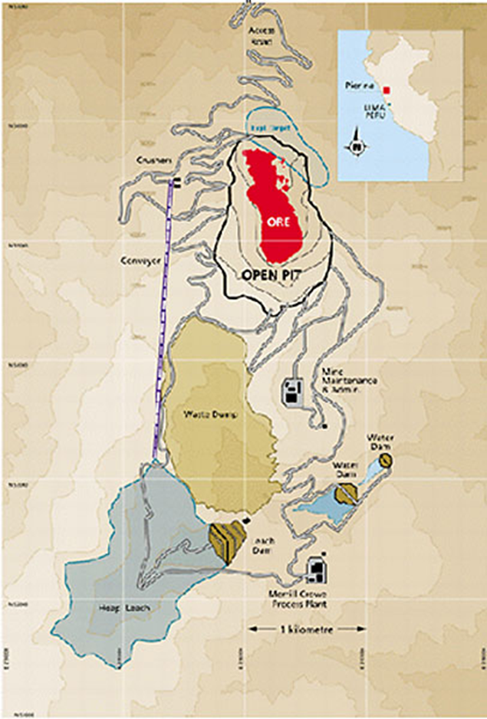

Slide 6
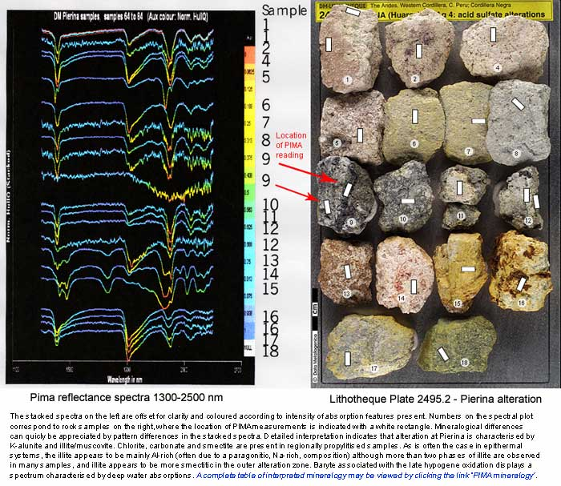

Slide 7
More than 95% of the ore at Pierina is oxidised, which is regarded as both supergene and hypogene, with overall higher grades of up to 90 g/t Au. Remnant, overprinted kernels of pyrite-enargite-covellite-native sulphur are found locally. The pre-oxidation phases of quartz-alunite acid leaching created a porosity for pervasive pyrite-enargite-covellite, and quartz-pyrite-Au veinlet stages with associated lower 0.5 to 2 g/t grades. The final barite-Au veinlet phase contains up to 1.5 g/t Au. The ore zone covers an area of 900x300 m. Pierina is operated by Barrick Gold Corporation's wholly owned subsidiary Minera Barrick Misquichilca SA.

Slide 8
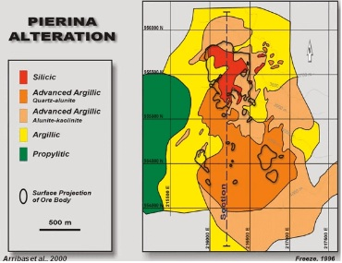

Slide 9
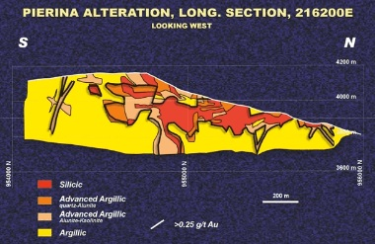

Slide 10
Thank you for your attention!

